Slide 2


NAGP
Complex is Simple
New Technology Exploration Group
Microservices Architecture
Session 2

Slide 3

Re-cap

Slide 4
What we talked about last time…
Distributed computing
Scalability
Load Balancing
Monolithic -> Service Oriented -> Microservices
Advantages of microservices
When to use microservices
Best practices
Deployment patterns
Dockers
Container orchestration

Slide 5
Demo Application
https://github.com/MohitNarula/msa-demo

Slide 6
Service Discovery & Service Registry

Slide 7
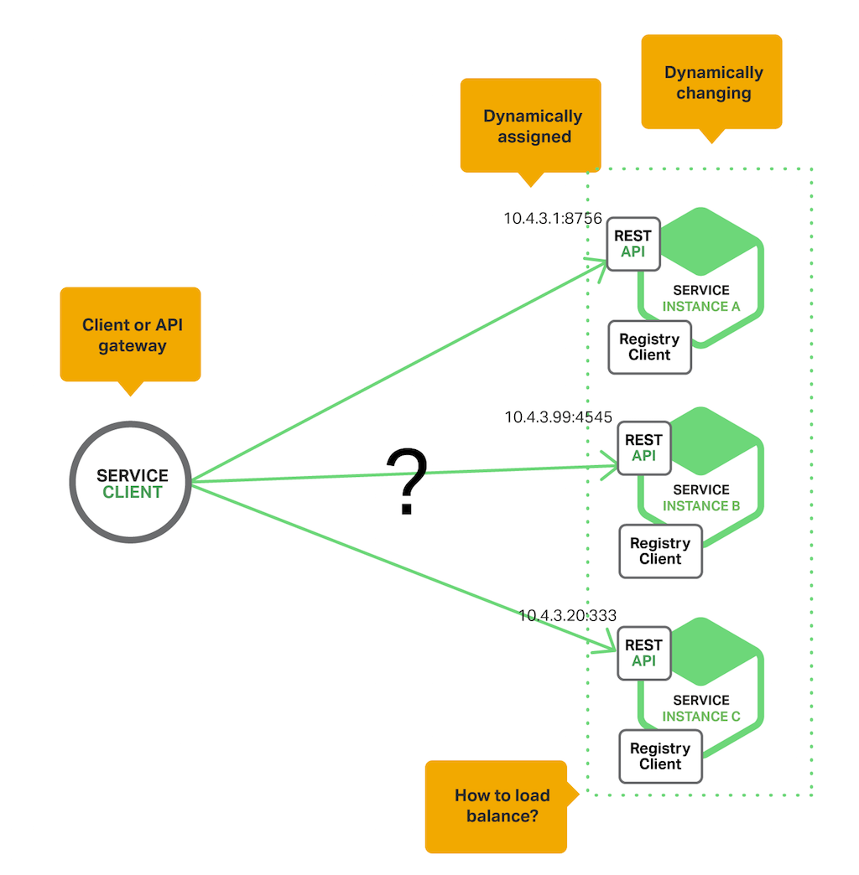
Service Discovery
How does Microservices know how many instances of Microservices are present, at a given time?

Slide 8
Working - Service Discovery
The service registry is a key part of service discovery. It is a database containing the network locations of service instances
Service Registration
service instances must be registered with and deregistered from the service registry
In addition to registering (and unregistering) a service when starting up and shutting down, service registration clients also should initiate a heartbeat system.
The process of returning the physical (network) location of a microservices
A typical microservice is deployed in multiple physical instances for availability and scalability, and the service resolution client must know how to return the address of the appropriate instance based on load, availability, and other factors.
For example, a service resolution client might use a round robin algorithm to cycle through the various addresses associated with a specific microservice.
Service Resolution

Slide 9
Registration Patterns
Self Registration Pattern
Third Party Registration Pattern

Slide 10
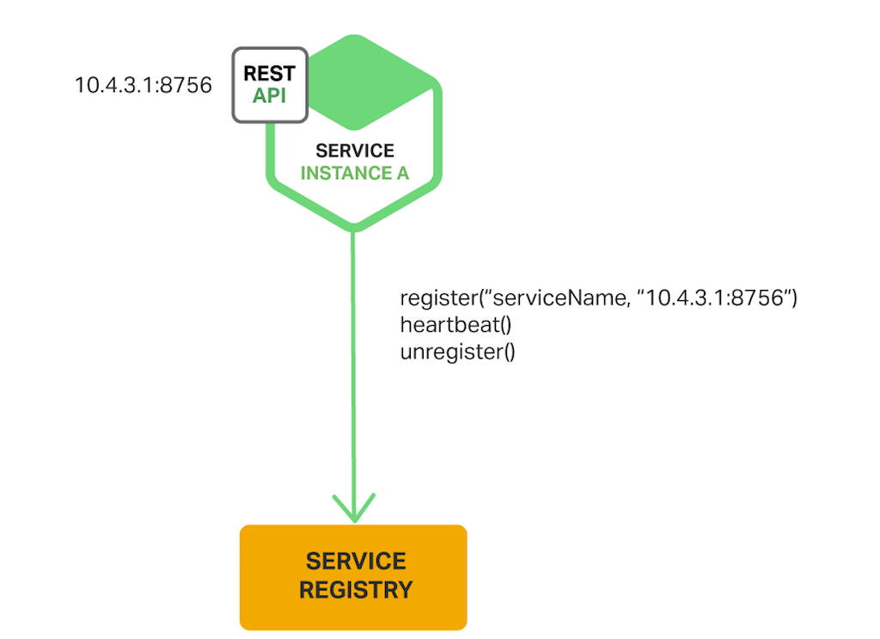
Self Registration Pattern
A service instance is responsible for registering and deregistering itself with the service registry. Also, if required, a service instance sends heartbeat requests to prevent its registration from expiring.
A good example of this approach is the Netflix OSS Eureka
Relatively simple
Couples the service instances to the service registry - You must implement the registration code in each programming language and framework used by your services.

Slide 11
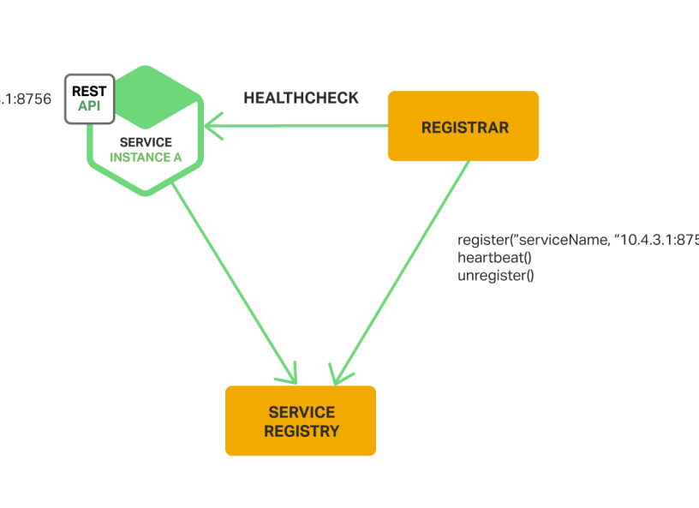
Third-Party Registration Pattern
service instances aren’t responsible for registering themselves with the service registry. Instead, another system component known as the service registrar handles the registration.
The service registrar tracks changes to the set of running instances by either polling the deployment environment.
One example of a service registrar is the open source Registrator project. It automatically registers and deregisters service instances that are deployed as Docker containers.
Services are decoupled from the service registry - you don’t need to implement service‑registration logic for each programming language and framework used by your developers.
unless it’s built into the deployment environment, it is yet another highly available system component that you need to set up and manage.

Slide 12
Service Discovery Patterns
Client-side Service Discovery
Server-side Service Discovery

Slide 13
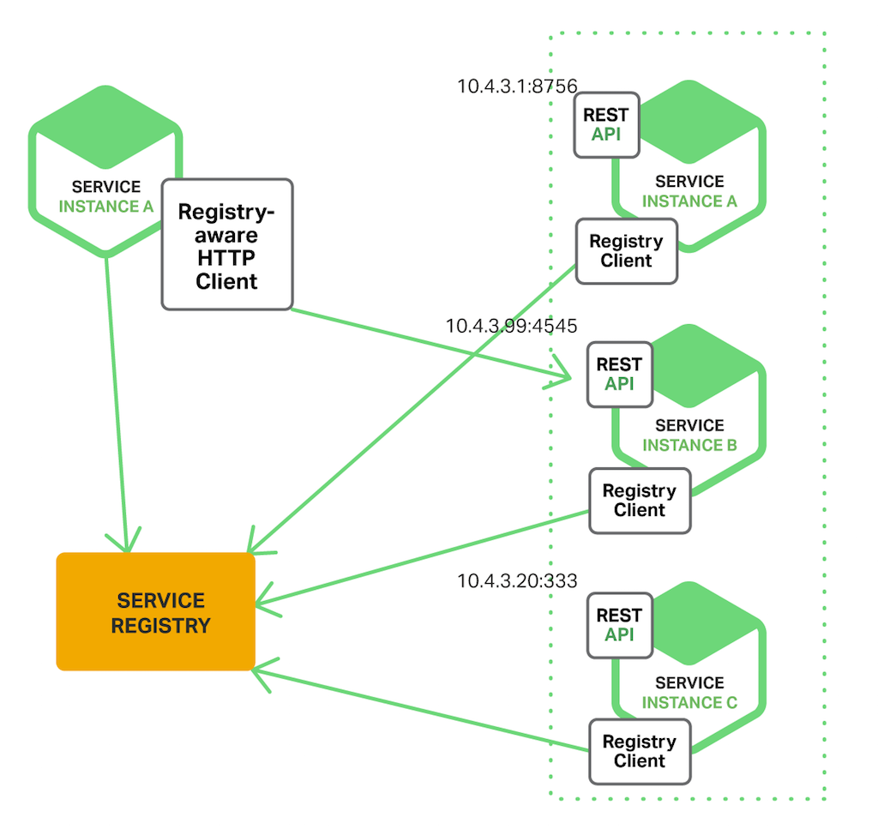
The Client‑Side Discovery Pattern
The client is responsible for determining the network locations of available service instances and load balancing requests across them.
The client queries a service registry, which is a database of available service instances. The client then uses a load‑balancing algorithm to select one of the available service instances and makes a request.
Netflix OSS provides a great example of the client‑side discovery pattern. Netflix Eureka is a service registry. It provides a REST API for managing service‑instance registration and for querying available instances.
Netflix Ribbon is an IPC client that works with Eureka to load balance requests across the available service instances.
The client knows about the available services instances, it can make intelligent, application‑specific load‑balancing decisions
Couples the client with the service registry

Slide 14
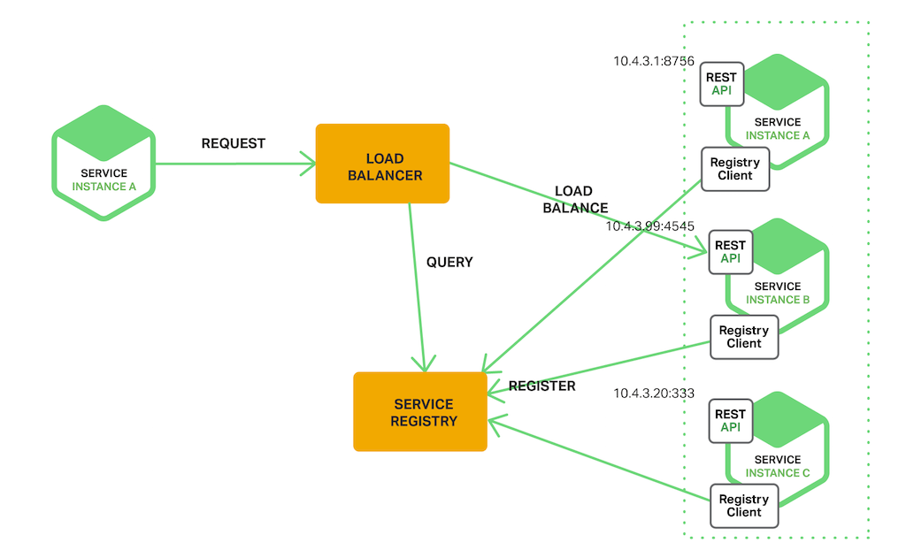
The Server‑Side Discovery Pattern
The client makes a request to a service via a load balancer. The load balancer queries the service registry and routes each request to an available service instance.
AWS Elastic Load Balancer (ELB) is an example of a server-side discovery router.
The ELB load balances the traffic among a set of registered Elastic Compute Cloud (EC2) instances or EC2 Container Service (ECS) containers.
Some deployment environments such as Kubernetes and Marathon run a proxy on each host in the cluster. The proxy plays the role of a server‑side discovery load balancer.
Details of discovery are abstracted away from the client.
some deployment environments provide this functionality for free.
Unless the load balancer is provided by the deployment environment, it is yet another highly available system component that you need to set up and manage.

Slide 15
API Gateway

Slide 16
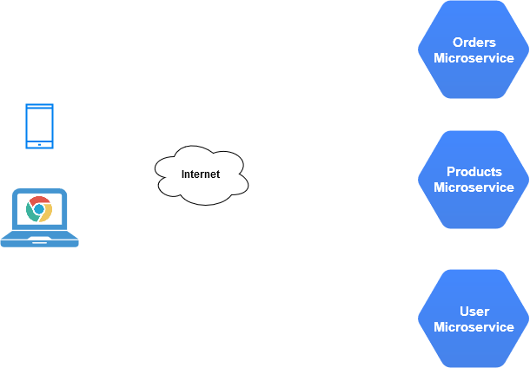
The Problem
An App with 3 Microservices needs to be accessed by Mobile App and Browser (Web App)

Slide 17
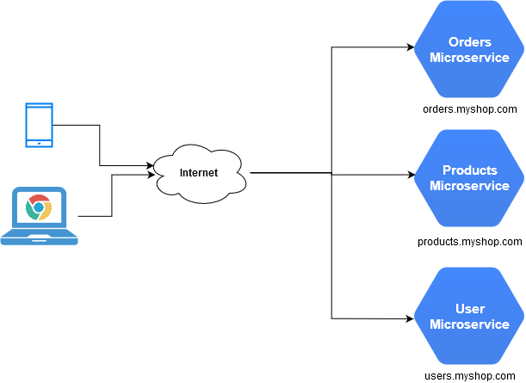
The Problem
An App with 3 Microservices needs to be accessed by Mobile App and Browser (Web App)
All microservices exposed to some IP/address

Slide 18
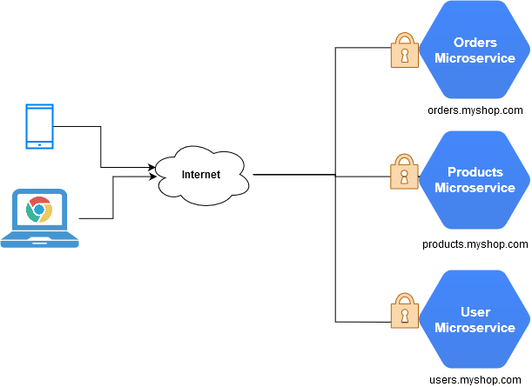
The Problem
An App with 3 Microservices needs to be accessed by Mobile App and Browser (Web App)
All microservices exposed to some IP/address
Publicly exposed endpoints need Security/Authorization

Slide 19
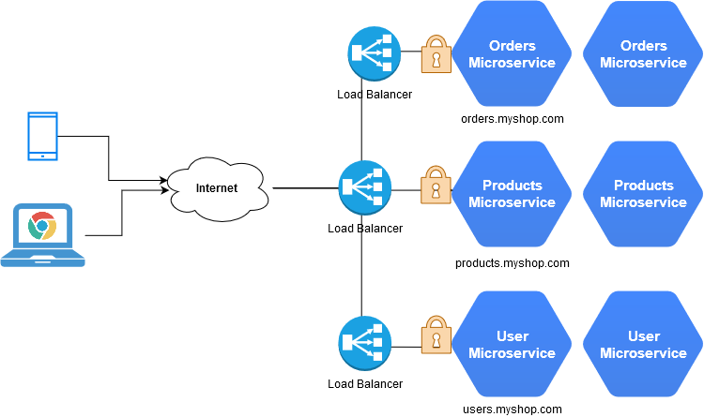
The Problem
An App with 3 Microservices needs to be accessed by Mobile App and Browser (Web App)
All microservices exposed to some IP/address
Publicly exposed endpoints need Security/Authorization
On Scaling, load balancers are added to all the services

Slide 20
The Problem
Multiple public endpoints
Redundant Security/Auth implementations
Multiple Load Balancing
Difficult upgrades
More maintenance
No Centralized API management

Slide 21
Solution?

Slide 22
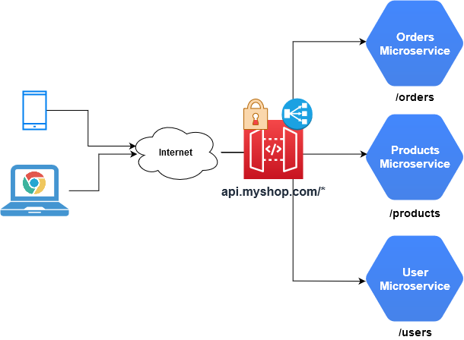
Solution - API Gateway

Slide 23

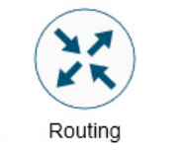

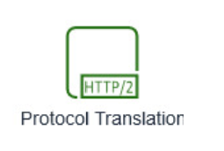
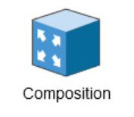
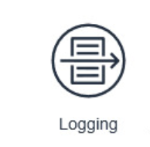


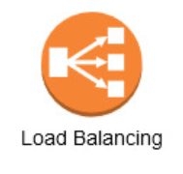
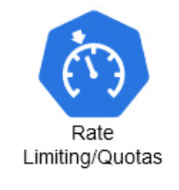
API Gateway - Features

Slide 24
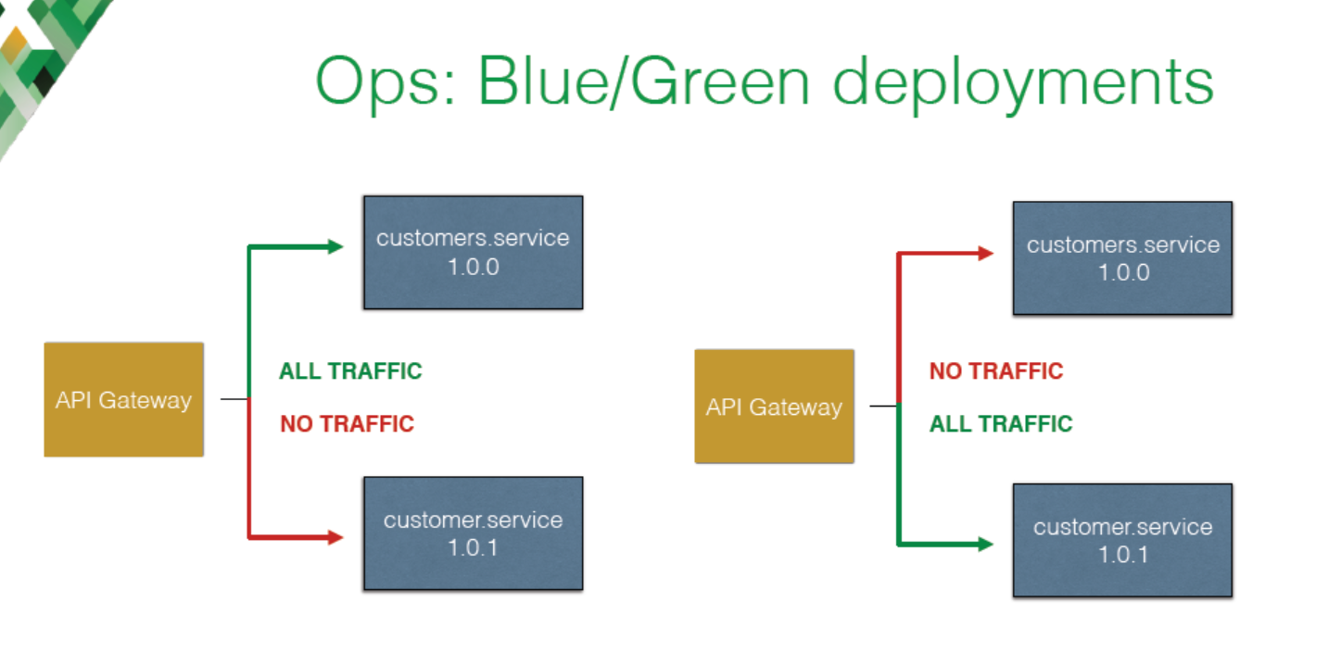
Rolling Updates

Slide 25
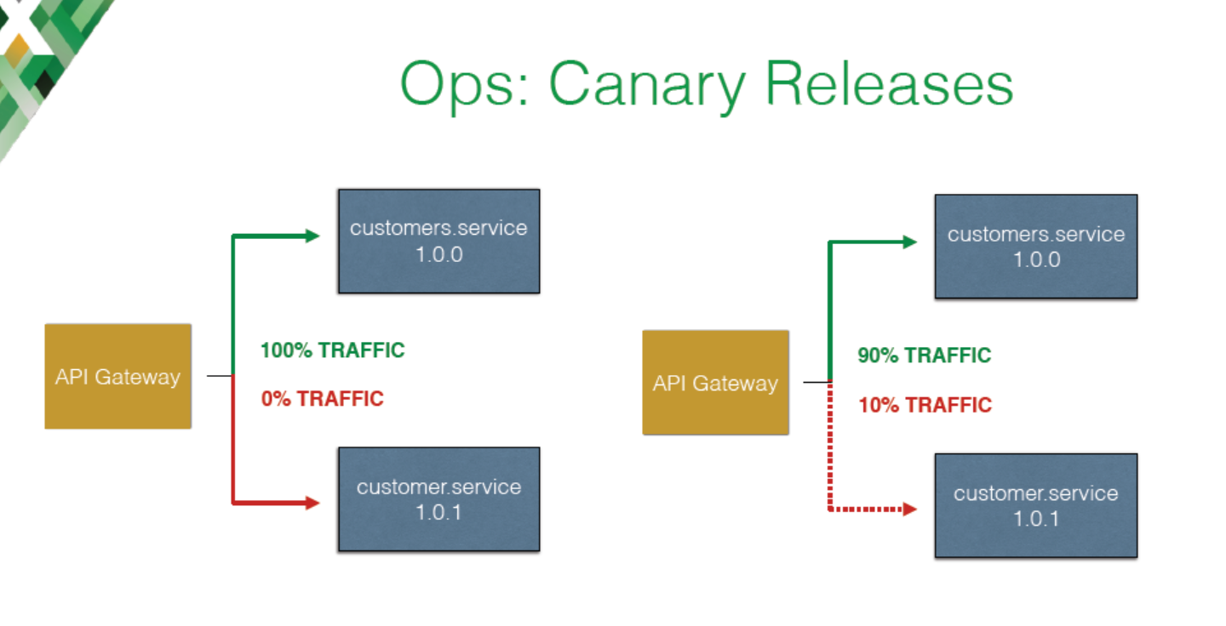
Rolling Updates

Slide 26
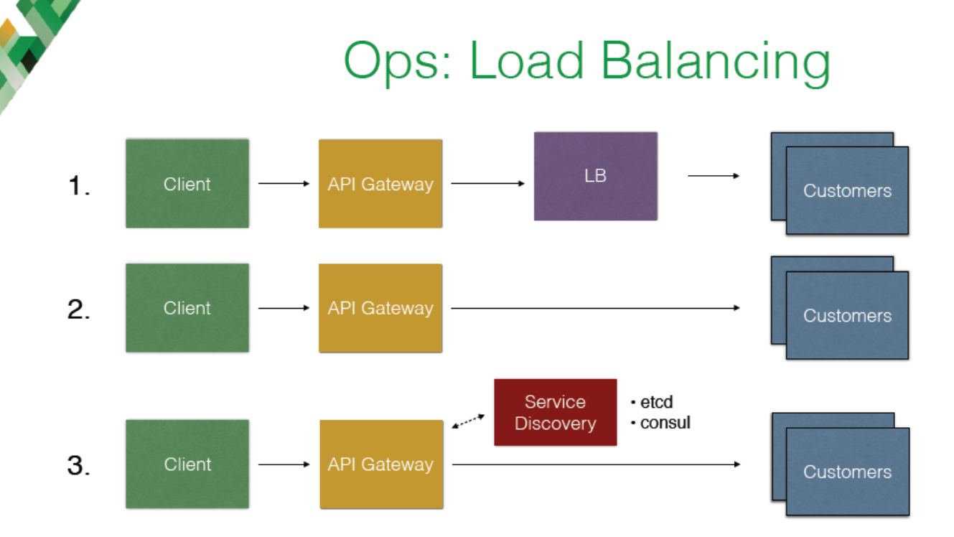
Load Balancing

Slide 27
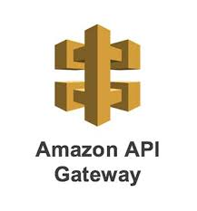



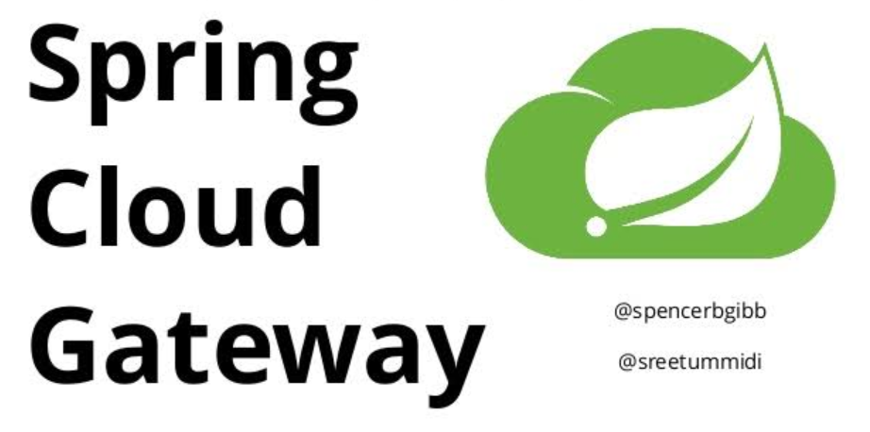
Popular API Gateways
Offering of Netflix OSS
Spring Cloud support Zuul 1
Easy integration with Spring applications
Zuul 2 supports websockets and asynchronous requests, but not as part of Spring Cloud
Spring Cloud Gateway supports asynchronous requests.
Supports better request matching/filtering
Supports websockets
Popular with applications hosted in AWS
Supports Authorization and Rate Limiting
Built over Nginx Router
Supports plugins written in Lua language
High Performance
A lot of community plugins
Much more than just an API Gateway
Provides API Management too like Monetization, Publishing etc.
Acquired by Google in 2016
Available in Google Cloud out of box

Slide 28



Slide 29



Slide 30


Slide 31
Load Balancing

Slide 32
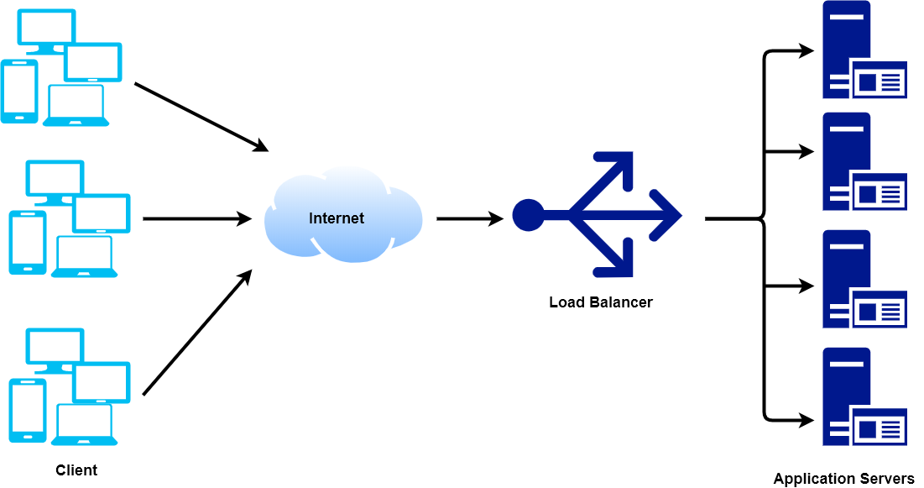
What are Load Balancers?

Slide 33
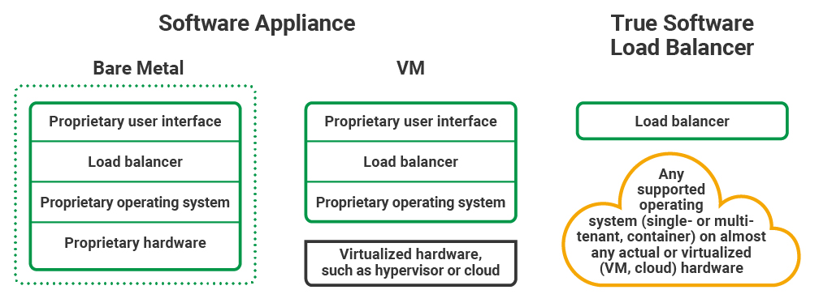
Hardware vs Software Load Balancers

Slide 34
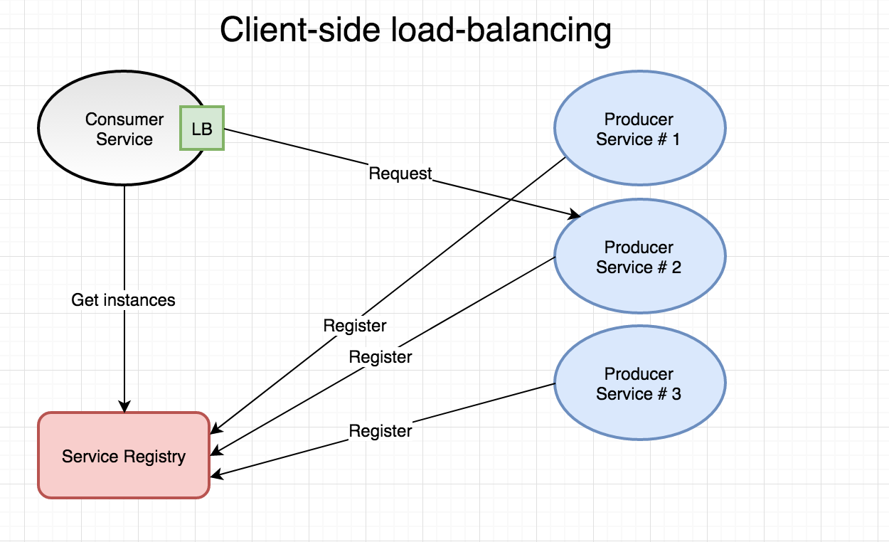
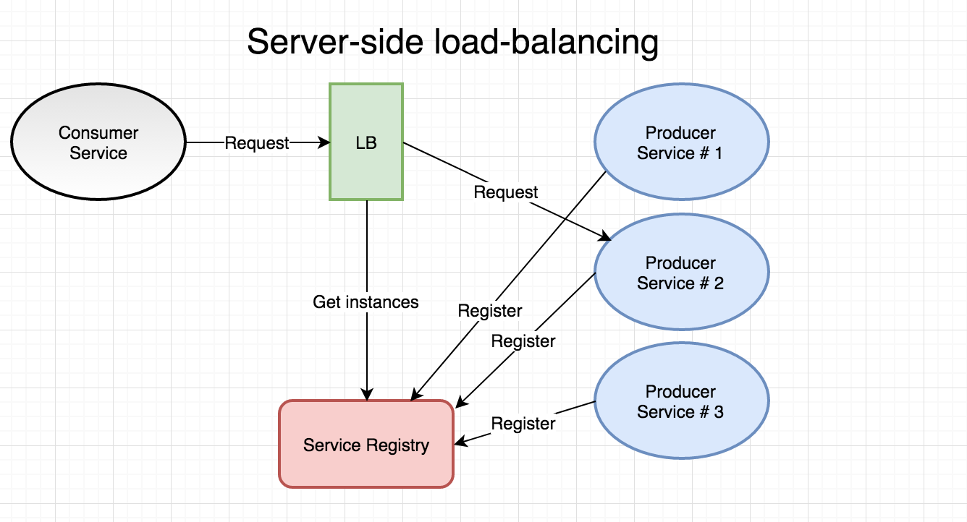

Slide 35
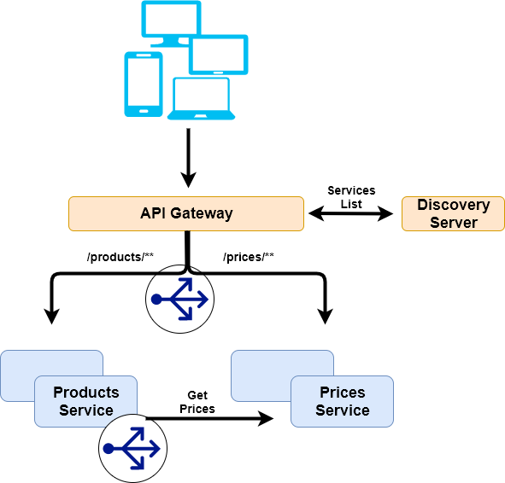
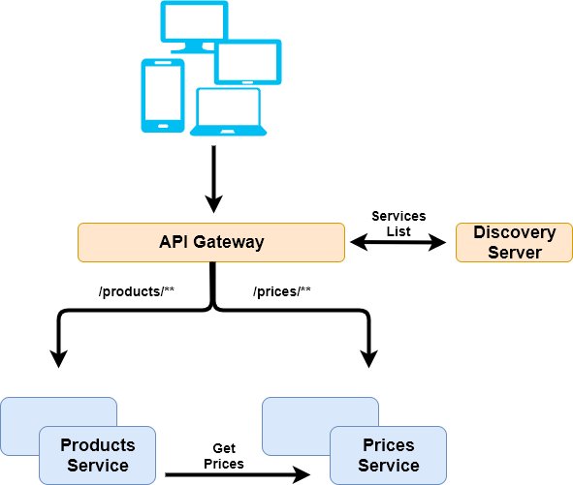
Where should we add Load Balancers?

Slide 36
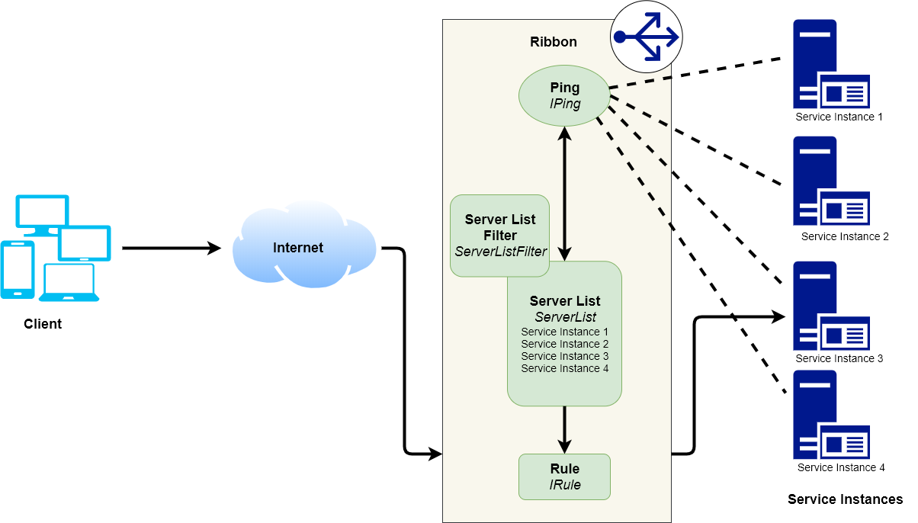
How does Ribbon internally work?

Slide 37
Ribbon Configurations for customized behavior
<clientName>.ribbon.
NFLoadBalancerClassName ILoadBalancer
NFLoadBalancerRuleClassName IRule
NFLoadBalancerPingClassName IPing
NIWSServerListClassName ServerList
NIWSServerListFilterClassName ServerListFilter

Slide 38
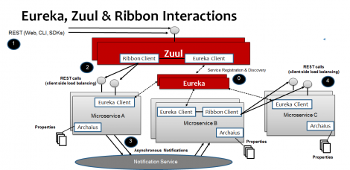
TODO: Try if we can replace with a better-quality image

Slide 39
Fault Tolerance
Circuit breaker pattern

Slide 40
Basic Flow
Product Service
http
Price Service
WebApp
request
response
thread assigned
threadpool

Slide 41


Timeout failure
Product Service
http
Price Service
WebApp
request
Waiting for response
Service could be overloaded
(One of many possible reasons)
request-1
request-2
request-N
threadpool

Slide 42
Timeout failure
Product Service
Price Service
WebApp
request
Cannot serve
requests
request N+1
request N+2
High request rate
Vs threads freed very slowly
= Resource exhaustion
request-N
threadpool

Slide 43
Cascading Failure
Product service
Price service

Slide 44
Goal
Product Service
Price Service
WebApp
request
Immediately return default response (so that our threads our not stuck)
Stop calling price service for some time.
Allow time to recover/scale up
threadpool

Slide 45

Use interceptor for all requests
Product Service
Price Service
WebApp
request
gatekeeper for all requests
call service
successful response
ALLOW
current status
requests interceptor

Slide 46
Stop calling remote service if failure occurs
But, how long to wait ?
Check last N calls for failure
Product Service
Price Service
WebApp
request
Allow time to resolve/scale up
call service
successful 70%
Percentage of failure in last N calls
failed 30%
default response for
subsequent requests
Stop if failure rate > threshold
STOP
Start a timer (duration?)
current status
requests interceptor

Slide 47
Re-allow partially once timer expires
Product Service
Price Service
WebApp
request
call service
allow some calls to go through to check if service is up now
default response (for most)
response/error (for some)
ALLOW PARTIAL
current status
requests interceptor

Slide 48
Status reset once service is back up
Product Service
Price Service
WebApp
request
call service
response/error (for some)
ALLOW
Reset status id service is really up
requests interceptor

Slide 49
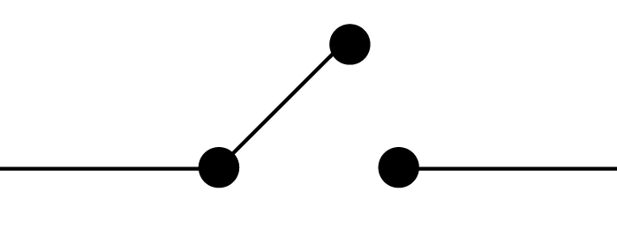
Circuit breaker pattern
Product Service
Price Service
WebApp
request
call service
Circuit Breaker
get response

Slide 50
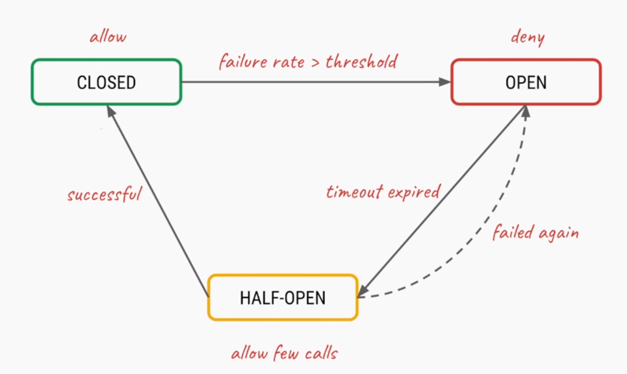
Circuit breaker pattern states

Slide 51
Thank you !!

